Slide 1
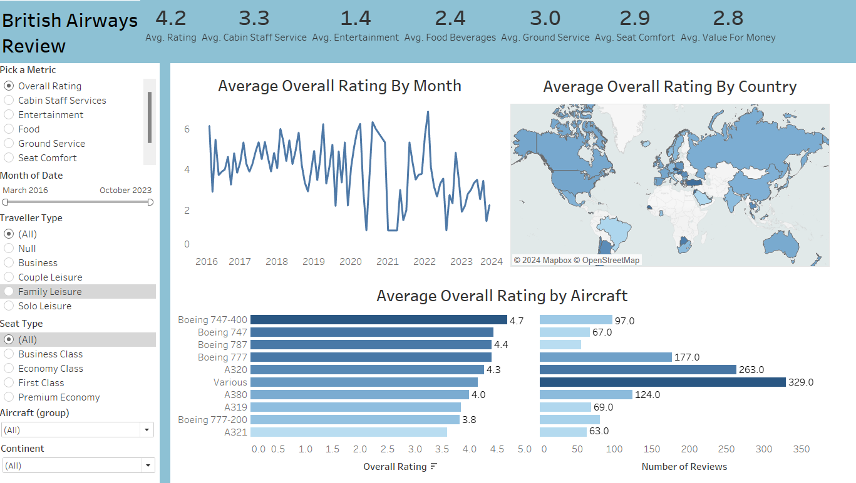
British Airways Review

Slide 2
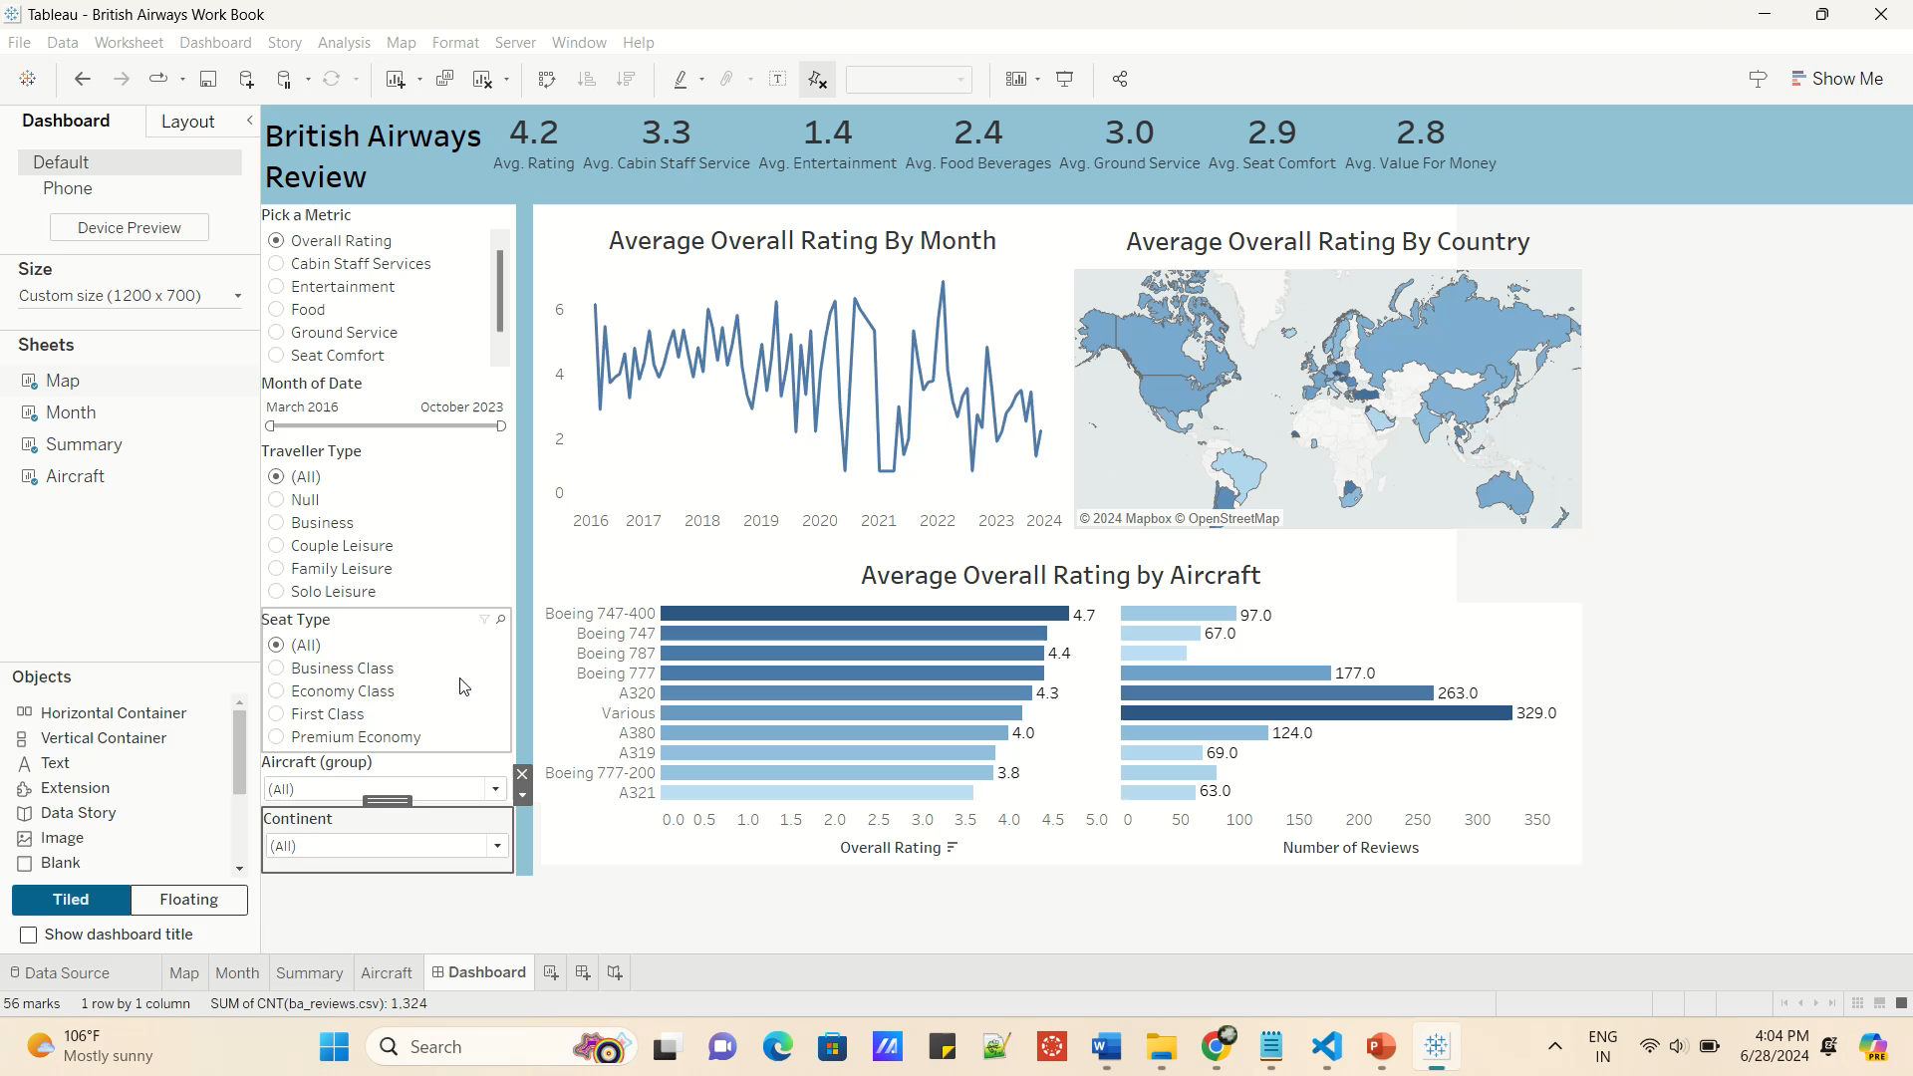

Slide 3
Git Hub Link

